Slide 1
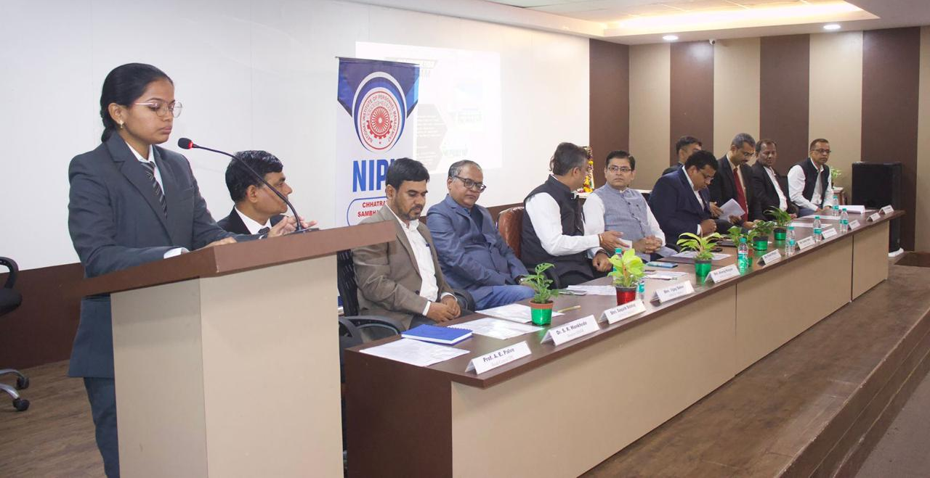
SHREEYASH PRATISHTHAN
Polytechnic | Engineering | Pharmacy | BAMS | MBA| BCA

Slide 2
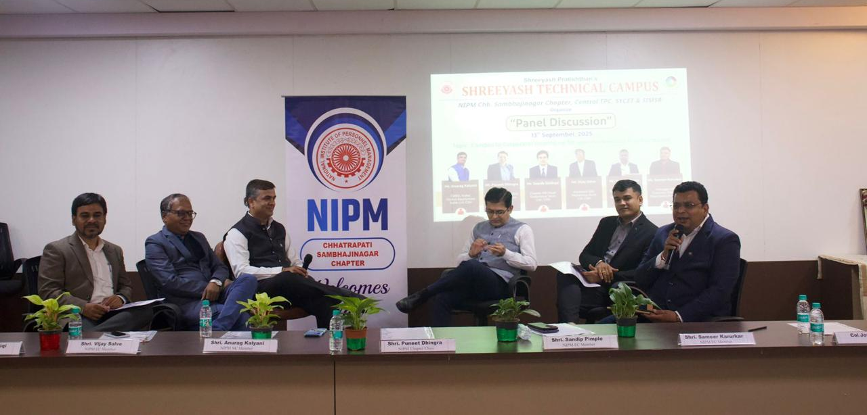
SHREEYASH PRATISHTHAN
Polytechnic | Engineering | Pharmacy | BAMS | MBA| BCA

Slide 3
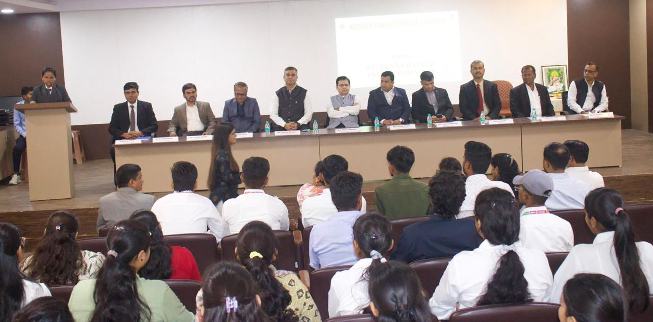
SHREEYASH PRATISHTHAN
Polytechnic | Engineering | Pharmacy | BAMS | MBA| BCA

Slide 4

SHREEYASH PRATISHTHAN
Polytechnic | Engineering | Pharmacy | BAMS | MBA| BCA

Slide 5
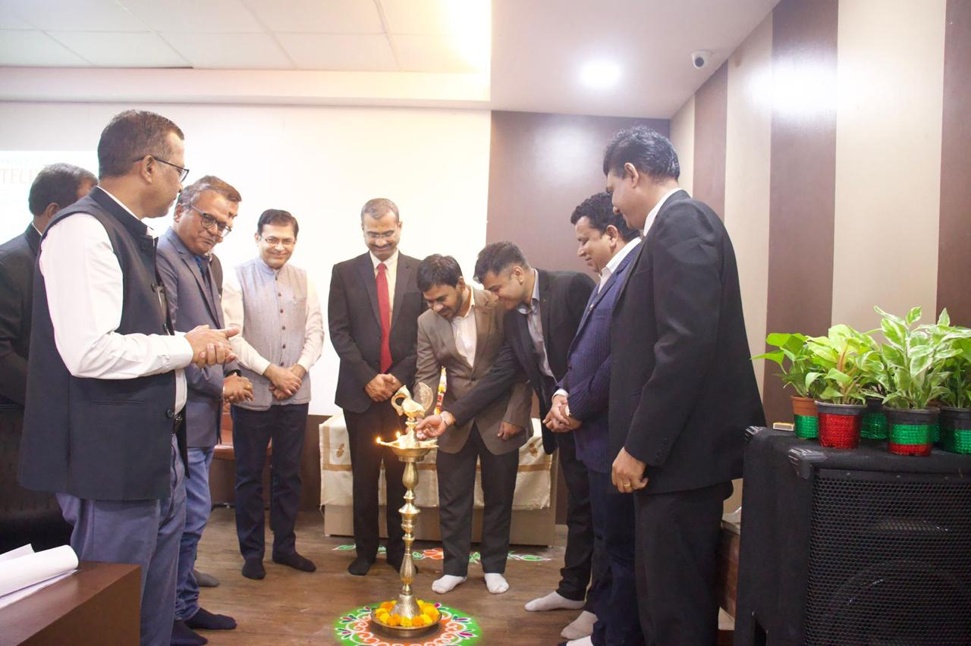
SHREEYASH PRATISHTHAN
Polytechnic | Engineering | Pharmacy | BAMS | MBA| BCA

Slide 6
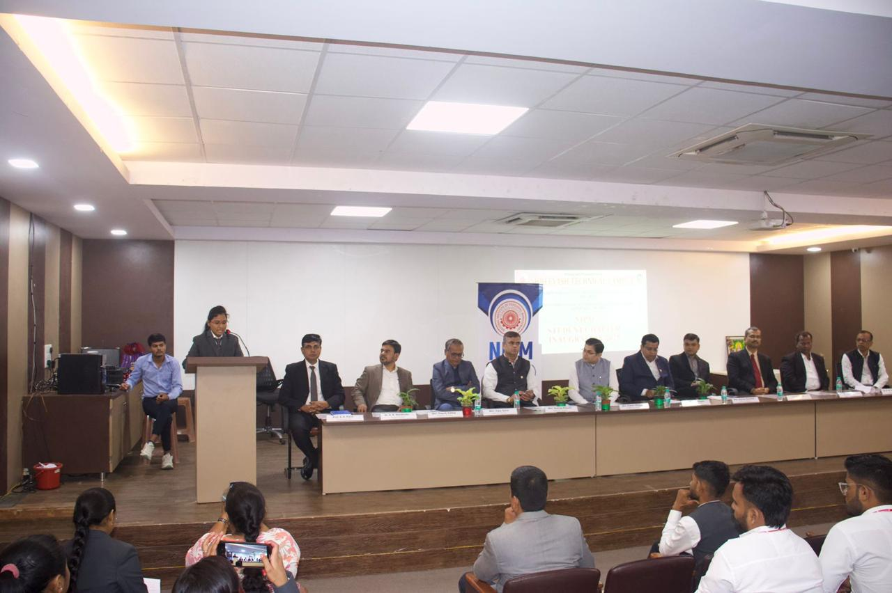
SHREEYASH PRATISHTHAN
Polytechnic | Engineering | Pharmacy | BAMS | MBA| BCA

